Slide 1

Assessing House Prices Using Linear Regression Model
DSI – SF
Emily Lin
Notes:
Good afternoon everyone, today I'm going to present to you my linear regression model that assesses the home prices in Ames Iowa.

Slide 2
Agenda
Problem Statement
Modeling Process
Conclusions
Recommendations and Limitation
Questions and Comments
Notes:
This is the agenda for today. I'm going to explain my problem statement...Walk everyone through my modeling process...I will explain my conclusion, recommendation, and limitation of this model. then I will open up the floor to any questions and comments.

Slide 3
Problem Statement
To find the most accurate linear regression model that assesses Ames housing price by identifying the appropriate indicators.
“The Assessor is responsible for assigning values to all taxable property within Ames' city limits. An on-going process of gathering and reviewing information, measuring and listing new construction and investigating sales of real estate is used to provide accurate and current values.”¹
Source:
https://www.cityofames.org/government/departments-divisions-a-h/city-assessor
Notes:
So let's define the purpose of this project.
The client of this project is the Ames Assessor’s Office.
The Assessor’s Office is responsible for ……
So it’s important to find the most accurate linear…..
Besides accuracy, it’s crucial that the model can be updated and replicated for future use, since the results generated from this model affects Ames resident’s property taxes and the city’s tax revenues.
I'm going to walk through my model process in this presentation and I will answer the question of what are the relevant predictors that affect home prices at the end.

Slide 4
Modeling Process
Data Cleaning
Exploratory Data Analysis
Modeling
Metrics
Featuring Engineering
Notes:
My modeling process is outlined here.

Slide 5
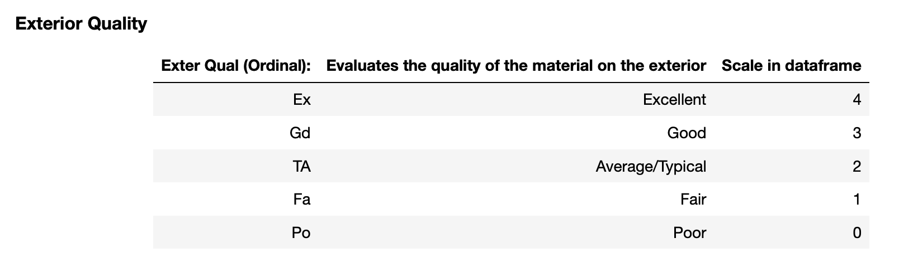
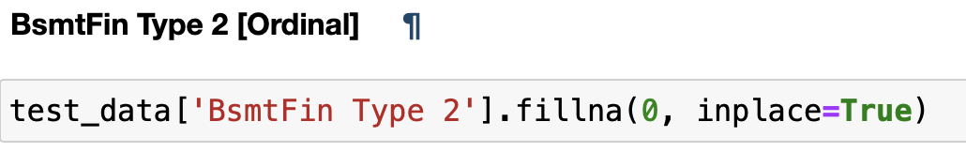
Data Cleaning
Goal: Don’t lose too much data by filling in the null values as much as possible.
Categorizing Ordinal Data
Lot Frontage
Lot Frontage
Filling in null values
Lot Area
Notes:
This first step to modeling is data cleaning.
It's important to keep a goal in mind when cleaning the data because it informs how I'm going to deal with missing values.
My goal is to not lose any data if I can fill them in.
So I looked at the data dictionary to figure out how what kind of data I'm working with first.
Any missing ordinal data, I filled them in according to the scale that’s used in the data collection process.
After fixing all the missing values, I replaced the ordinal data that’s a string with a numerical value that corresponds to the original scale.
Lot Frontage is the one that gave me the most trouble with about 300 total missing values. I actually did a simple linear regression to fill in the null values of lot frontage.

Slide 6
Exploratory Data Analysis
Notes:
After cleaning data, I plotted the numerical values against sale price. These are the 7 that I chose to include in my initial model.
The reason behind this is that they look fairly linear to sale price.

Slide 7
Linear Regression Model
TRAIN METRICS:
24473.45
Mean Absolute Error
37720.22
Root Mean Squared Error
0.77
R2
Predictors
Overall Quality
Mason Veneer Area
Total square feet of basement area
Above grade (ground) living area square feet
Size of garage in square feet
First Floor square feet
Second floor square feet
TEST METRICS:
24328.06
Mean Absolute Error
34369.98
Root Mean Squared Error
0.83
R2
After attempting log transformation:
TRAIN METRICS:
23134.07
Mean Absolute Error
56981.66
Root Mean Squared Error
0.47
R2
TEST METRICS:
21031.67
Mean Absolute Error
29358.19
Root Mean Squared Error
0.87
R2
Notes:
Overall Qual Total, Bsmt SF 1st Flr SF, Gr Liv Area, Mas Vnr Area, 2nd Flr SF, Garage Area, paved, new or con, Central Air, Electrical, Kitchen Qual, Neighborhood Codes

Slide 8
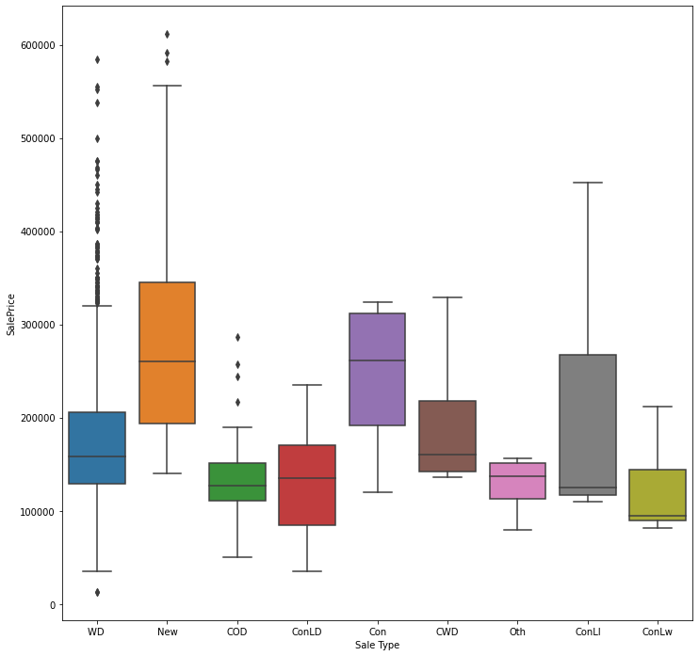
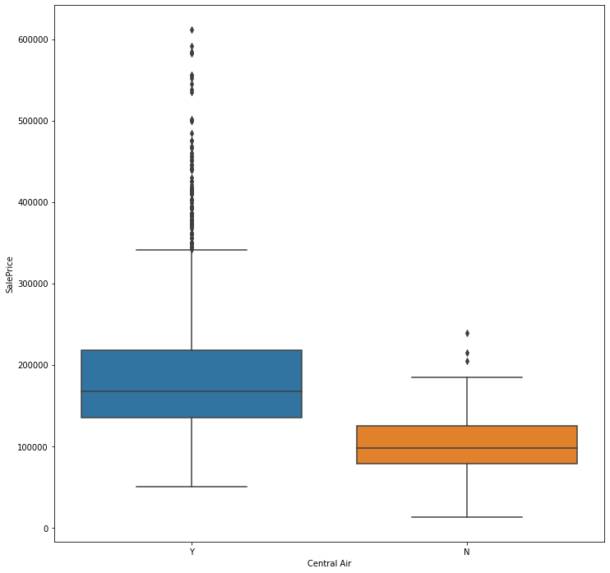
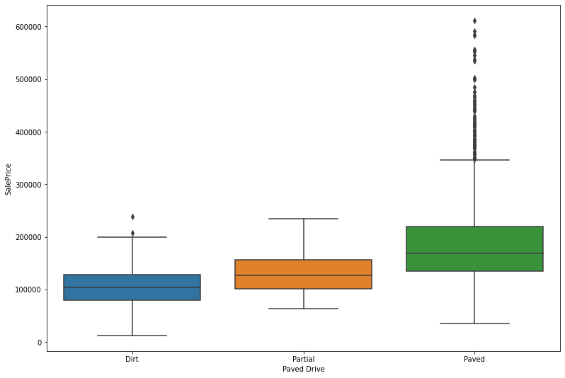
More EDA
Notes:
Contract 15% Down payment regular terms
Home just constructed and sold
Paved Drive (Ordinal): Paved driveway Y Paved P Partial Pavement N Dirt/Gravel

Slide 9
Linear Regression Model
Predictors
Overall Quality
Mason Veneer Area
Total square feet of basement area
Above grade (ground) living area square feet
Size of garage in square feet
First Floor square feet
Second floor square feet
Paved Drive [Engineered]
Sale Type (New or Con) [Engineered]
Type 1 finished square feet
Central Air
Electrical
Kitchen Quality
Neighborhood Codes [Engineered]
(1 for neighborhoods below average housing price, 1.5 for right at average or under 75th percentile, 2 for above 75th percentile)
After more data cleaning and feature engineering:
TRAIN METRICS:
17137.33
Mean Absolute Error
24234.81
Root Mean Squared Error
0.90
R2
TEST METRICS:
16582.7
Mean Absolute Error
23463.17
Root Mean Squared Error
0.92
R2
Notes:
Overall Qual Total, Bsmt SF 1st Flr SF, Gr Liv Area, Mas Vnr Area, 2nd Flr SF, Garage Area, paved, new or con, Central Air, Electrical, Kitchen Qual, Neighborhood Codes
When is it good enough to stop?
I actually had another iteration of this model but the marginal return on diminishing my RMSE and MAE is very low. So adopting occam’s razor, I wrapped up with this simpler model that can be easily modified, replicated, and evaluated for future use.

Slide 10
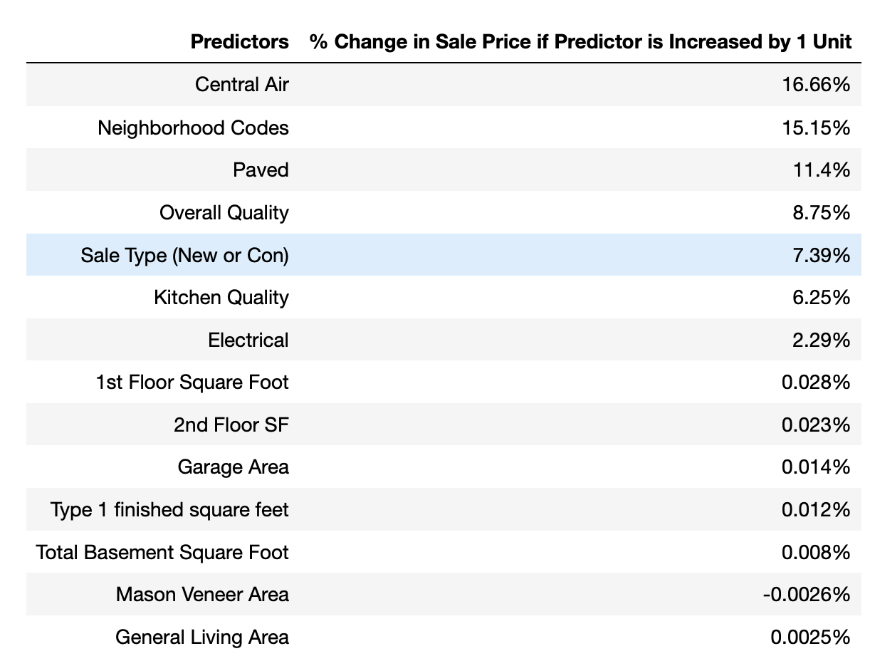



Conclusions
Sale Price
$500,000
General Living Area
(all else held equal)
$501,250
Constant = 27473.7
Notes:
So what are the predictors that affect home prices in Ames, Iowa.
Looking at this chart, you might have lots of questions. Beause isn’t it common sense that general living area (sq ft) affects housing prices more? Why does central air have highest % change?
And that’s because the highest predictors in this model are all categorical or binary. So a 1 unit change affects the model more but if we interpret the coefficients using real life example, they will be more clear.
Five hundred one thousand two hundred and fifty dollars.
But an average size of a bedroom is about 132 sq ft so the range for the general living area is greater than central air or paved drive. So in real life application, the predictors with lower percentage in this chart actually affects the sale price more.

Slide 11
Recommendations and Limitation
Overall Quality, Kitchen Quality
All agents are familiar with guidelines and rubrics.
Have more than one agent to evaluate a house.
Questions, Comments, Concerns?
Notes:
Models rely accurate data collection. And in this model, there are two factors that the assessor’s office has direct control over the accuracy. They are overall quality, and kitchen quality.
If the assessor’s office is adopting this model, it’s important that the office have standardized guidelines on how to rate houses and have more than one agent to evaluate a house to reduce bias.

